Slide 1

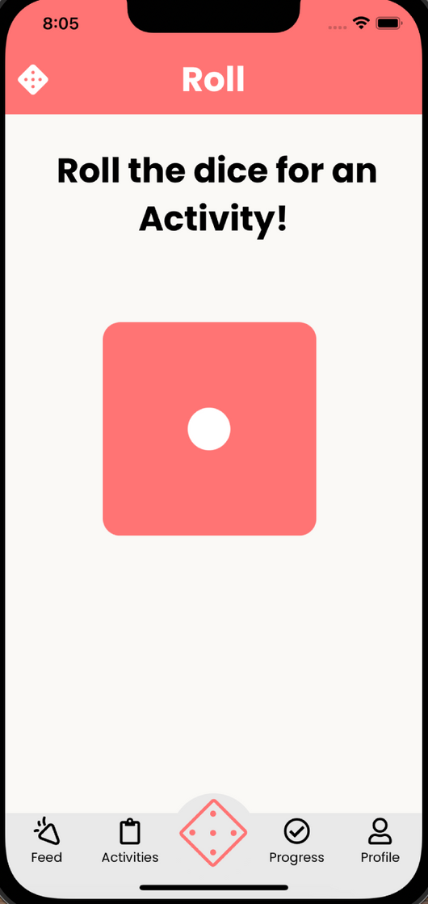


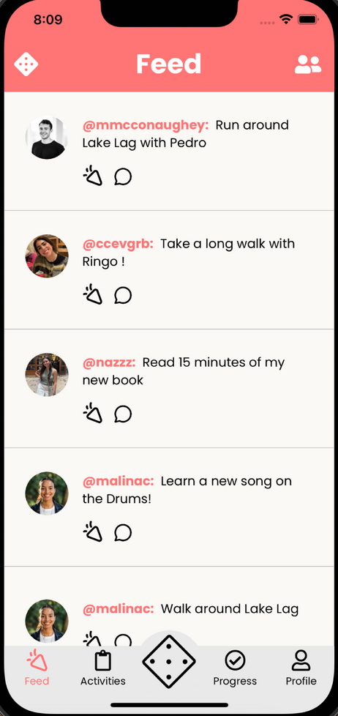
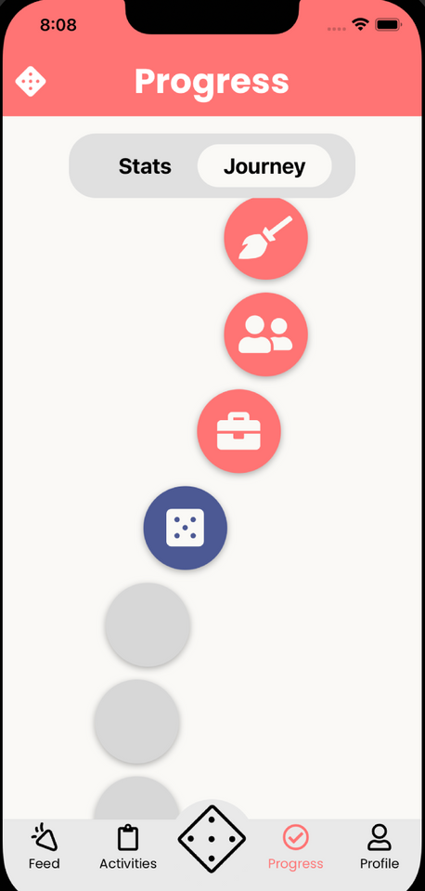
Malina, Karina, Caleb, Abbie
CS 194H Presentation 2
turno
Roll your way through the day

Slide 2
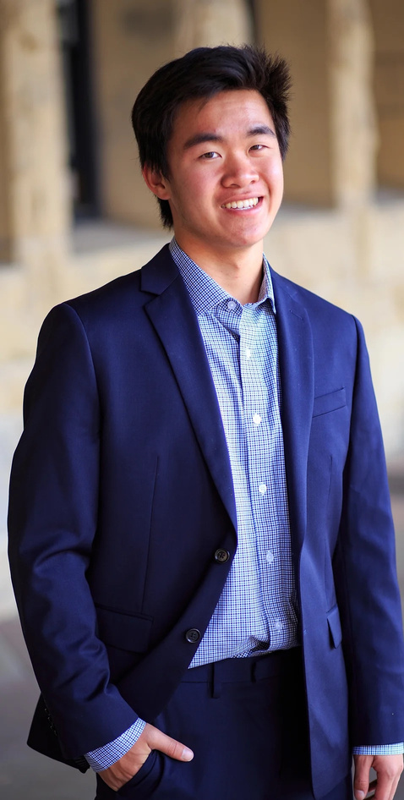
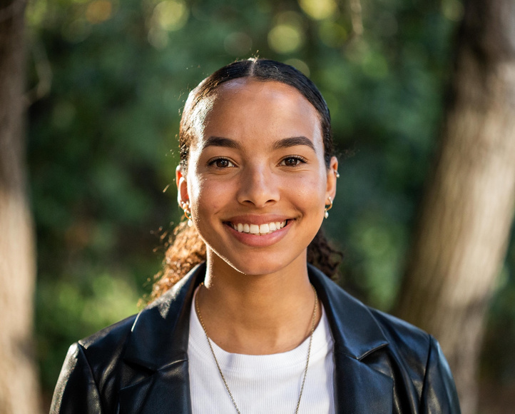


turno
Presentation 2
our team
Caleb Liu
Web + Mobile Developer
UI/UX Designer
Malina Calarco
Web + Mobile Developer
UI/UX Designer
Member of Fall 2023 Team
Abbie Maemoto
Web + Mobile Developer
UI/UX Designer
Karina Li
Web + Mobile Developer
UI/UX Designer

Slide 3
turno
Presentation 1
problem
Our world is saturated with choices, from what to eat to what to watch, wear, or buy. This barrage of decisions leads to endless debates, indecisiveness, and precious time lost that could be spent actually doing those tasks
solution
Turno simplifies choice-making with a digital dice where each side maps to user-input options. It’s a streamlined activity prompter that transforms the chore of choosing into a fun and quick activity, freeing up time and mental energy.

Slide 4

Initial Prototype Changes
1
Turno
Agenda
Usability Test Method
2
3
Results

Slide 5
Initial Prototype Changes
1
Turno
Agenda
Usability Test Method
2
3
Results

Slide 6
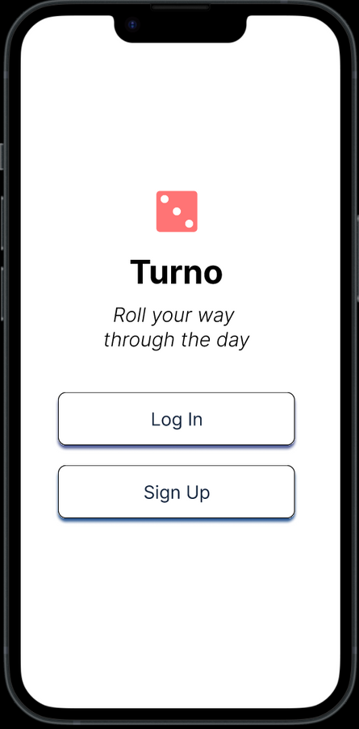
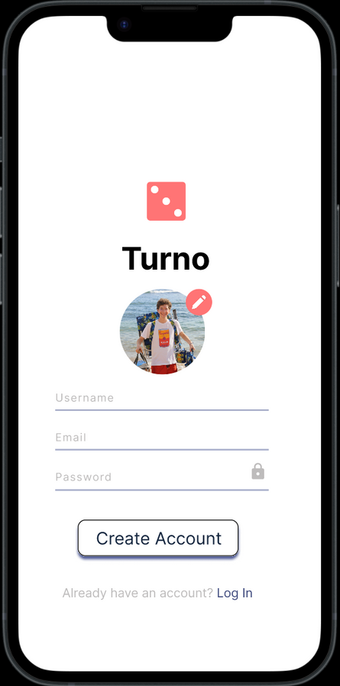


Initial Prototype Changes
Onboarding
Implemented the ability to create a unique Turno account through Firebase Authentication
Gives flexibility to store user data in a database in the future (ex: saved dice, search history)

Slide 7
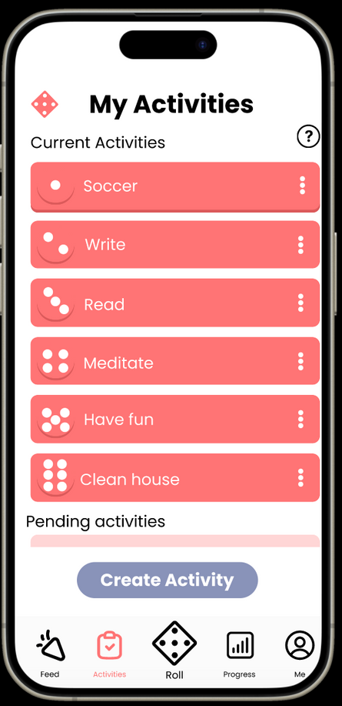
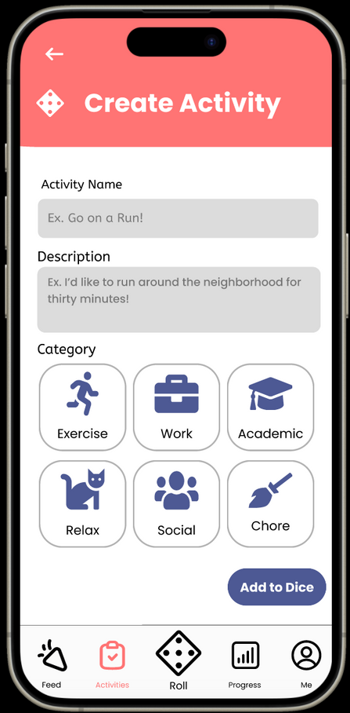
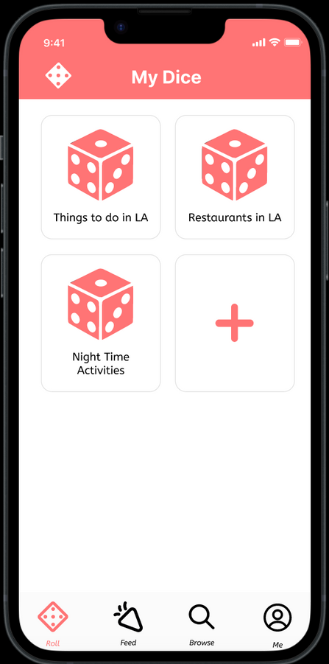
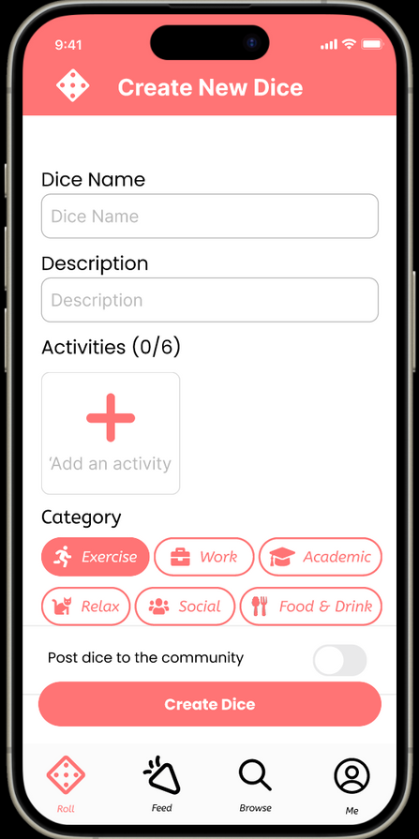
Initial Prototype Changes
Design Changes: My Dice
Before
After

Slide 8

Initial Prototype Changes
Design Changes: My Dice
Before
After
Ability to create multiple dice
User creates dice where each side of the dice is a user-selected activity
Option to post to community dice

Slide 9
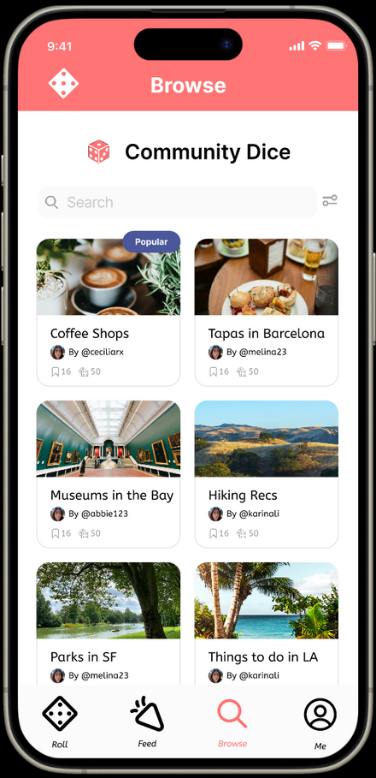
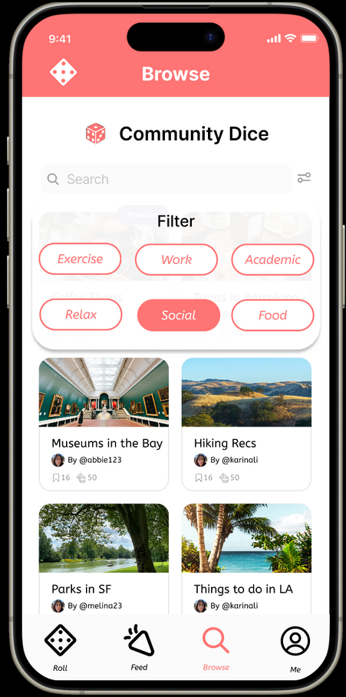
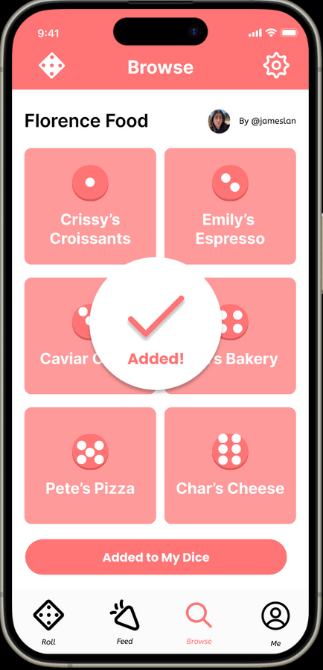
Initial Prototype Changes
Design Changes: Browse Dice
Ability to search for & roll other users’ dice
Can add community dice to personal suite of “My Dice”

Slide 10
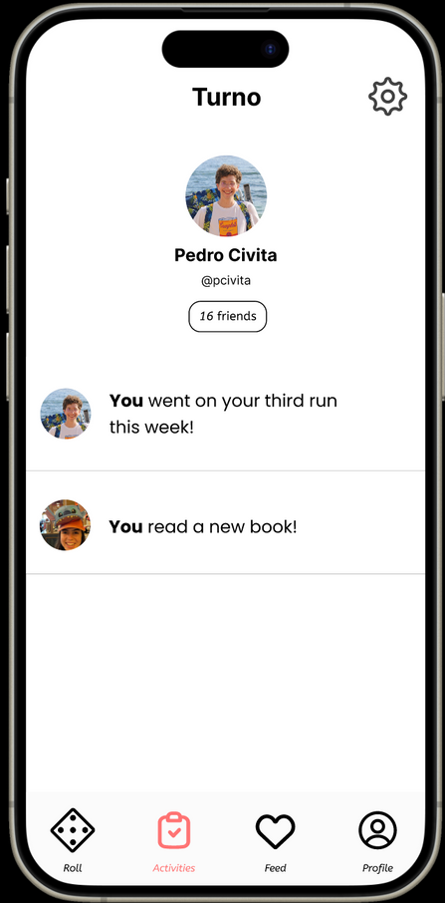
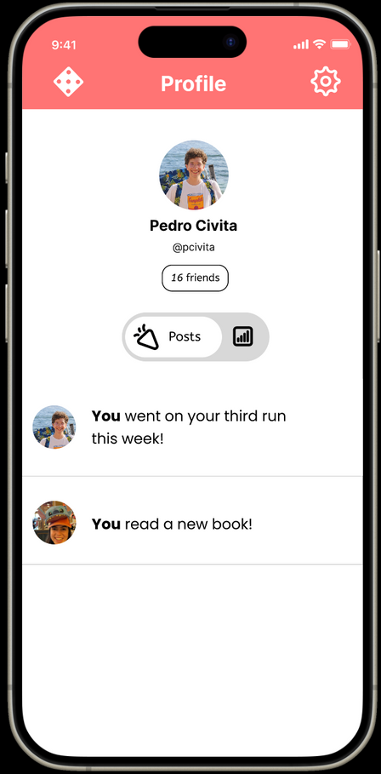
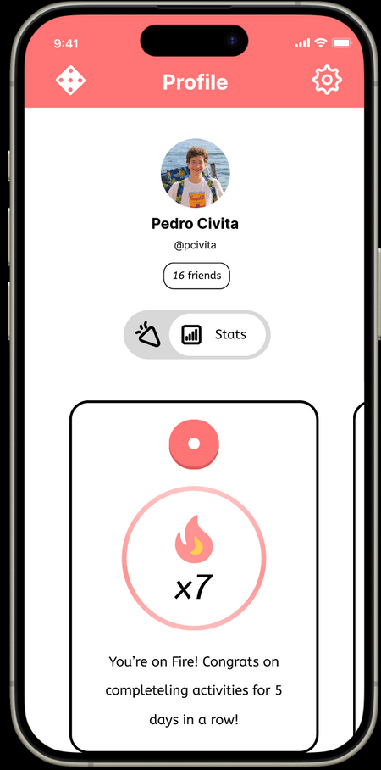
Initial Prototype Changes
Design Changes: Profile
Before
After
Consolidated the “progress” and “me” page into a single profile screen
Updated the types of Stats that are available

Slide 11
Initial Prototype Changes
Code Changes
Major
Restructured roll process to incorporate selection or creation of a dice, followed by rolling action (instead of the previous direct roll prompt)
Moved database calls from Supabase to Firebase
Created Browse page for users to explore Community Dice

Slide 12



Initial Prototype Changes
Code Changes
Minor
Removed Journey component to focus more on engaging with a variety of activities rather than following singular dice and path
Moved Stats component to be featured on Profile page
Added additional animation & shadow to dice when rolling

Slide 13
Initial Prototype Changes
1
Turno
Agenda
Usability Test Method
2
3
Results

Slide 14
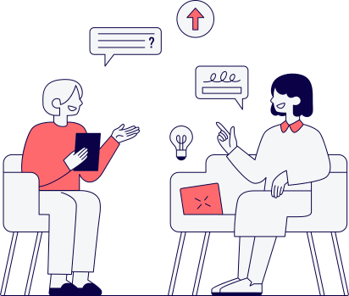
Method
Usability Test Method
Participants
Target audience: Young people who would find our approach to the gamification of solving decision paralysis useful and entertaining
How: scheduled & randomized interviews
Pre-scheduled interviews with potential users from our personal networks
Randomized interviews with people sitting at dining halls/Tressider for greater variety
Compensation: promise that they could be our first set of users in our final usability test of the quarter :)

Slide 15





Method
Method
Participants
DALL-E
DALL-E
DALL-E
DALL-E
DALL-E
Kabir J.
Stanford Student
Alex P.
Stanford Student
Emily L.
Stanford Student
Gaby C.
Stanford Student
Josh K.
Stanford Student

Slide 16


Method
Method
Apparatus
Software: Expo Go, React Native, video camera, Excel sheet for recording usability metrics
Equipment: iPhone to run Expo prototype and record usability test
Locations: Twain lounge, Toyon lounge

Slide 17

Method
Method
Tasks
Task 1: Create an account and log into the app
Task 2: Roll a dice and complete an activity
Task 3: Interact with user posts
Task 4: Find a dice on the community page and add to “My Dice”

Slide 18

Method
Method
Procedure
Read usability test
script introduction
Brief Expo Go
run-through
Explain task to
complete to user
Start recording
Ask task follow-up questions from script
Give user guidance
if unsuccessful in completing a task
Take notes on
usability metrics
Once all tasks completed, user is asked a final set of questions about the overall UX and are given the opportunity to be interviewed again for future iterations

Slide 19

Method
Method
Test measures
Time spent creating an account
Number of errors when completing an activity
Ratio of users clicking “Post” vs “Done” upon activity completion
Number of people who choose to comment
Misclicks when interacting with user posts

Slide 20
Initial Prototype Changes
1
Turno
Agenda
Method
2
3
Results

Slide 21
Results
Results
 | Time Spent Creating an Account | # errors when completing an activity | Clicked “post” vs “done”? | Did the person comment? | Misclicks when interacting with user posts
Alex | 46s | 5 | Post | Yes | 7
Emily | 32s | 3 | Post | Yes | 4
Kabir | 57s | 2 | Done | Yes | 2
Gaby | 39S | 4 | Post | No | 2
Josh | 19s | 1 | Post | Yes | 3

Slide 22

Results
Creating + Rolling Dice
Key Findings
Modifications
Confusion about how to roll dice
Tap/Shake phone
Dice creation felt repetitive/tedious
Two separate description fields
Unclear about having to create 6 activities in total
Navigation bar unclear that “Roll” is the “My Dice” page
Including an arrow with a pop up when rolling so user knows to swipe
Simplifying dice creation by making descriptions clearly optional
Change messaging on Activities “Up to 6”
Modify navigation bar titles

Slide 23
Results
Interacting w/ User Posts
Key Findings
Modifications
Wanted clickable and expandable posts
Icons were difficult to click
Interface had slow responsiveness
Issues with keyboard disappearance
Add ability to click on profiles such that comments and “Kudos” are expandable
Larger icons for interaction points
Make all icons clickable even when keyboard is available

Slide 24
Results
Browsing Community Dice
Key Findings
Modifications
Was not intuitive that community dice were located under “Browse”
Users liked the community aspect of the app
Users thought the filter and search would be helpful
Change “Browse” on the navigation bar to “Community” with a corresponding icon
Need to implement updating the database in “My Dice” when user adds from the community page
Need to make filtering and searching functional

Slide 25
Results
Lack of Instruction + Help
Key Findings
Modifications
Users were very confused about how to roll a dice
Navigation bar was not clear. The page details and the text on the tab did not align.
Confusion when creating a dice
Confusion on how to actually get to rolling the dice
Add background information about the app and basic functionality in the onboarding
Implement automated tags and pop-ups throughout the app to provide more clarity on functionality

Slide 26
Results
Next Steps
Implement all design modifications
Make more progress on database integration
Field Usability Test on non-students

Slide 27
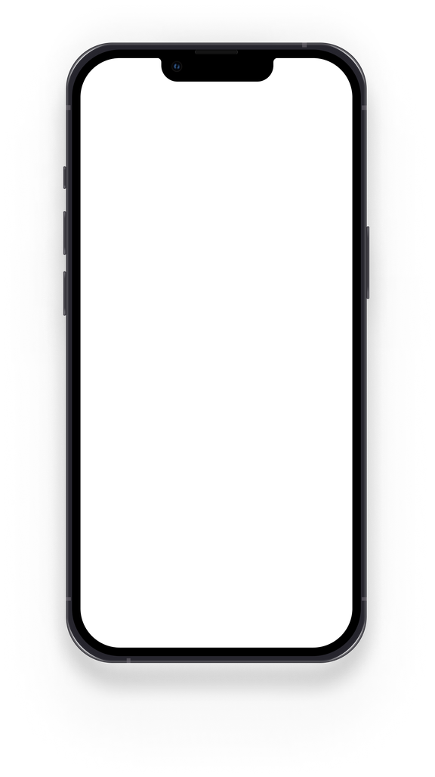
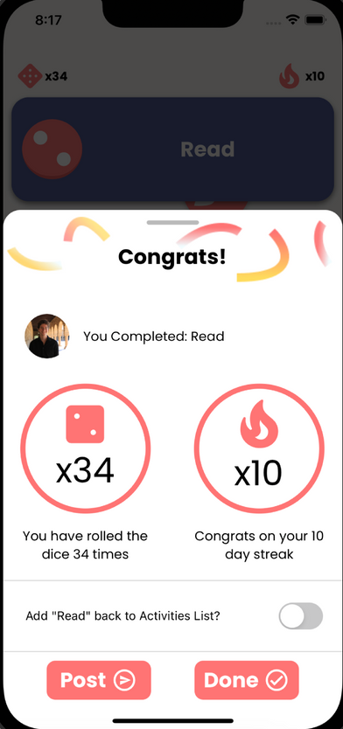
Thank you!
https://web.stanford.edu/class/cs147/projects/DesigningforActiveLifestyles/Turno/

